Slide 1


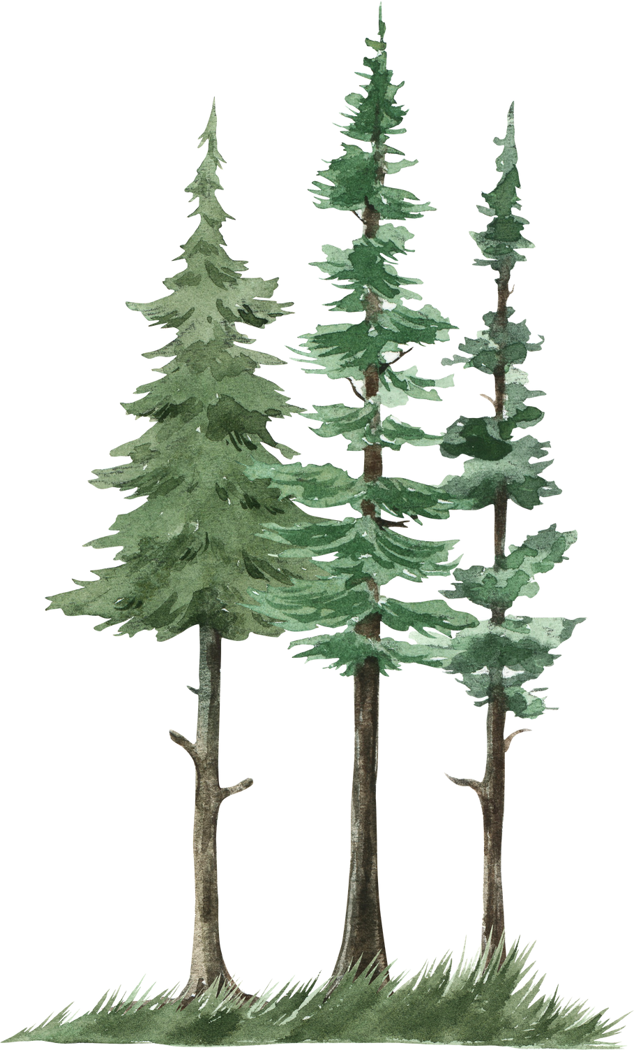
Radiometric thermal Imagery for
wildfire management
By
Ishan Toraskar (123B1F119)

Slide 2
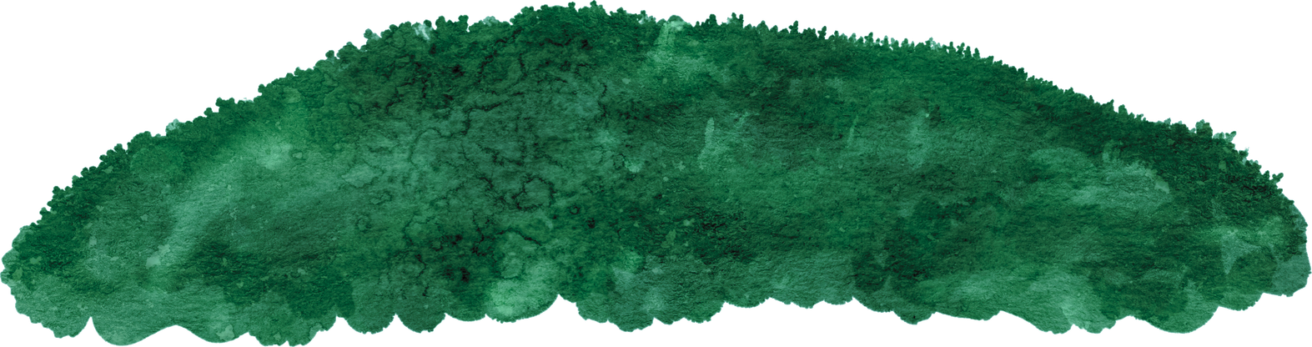
aim & Objectives
The aim of this project is to develop an intelligent wildfire detection and management system using UAV-acquired thermal and RGB imagery integrated with deep learning and image processing techniques. The system seeks to accurately classify fire and non-fire regions in real time, minimize false alarms, and enhance situational awareness for early intervention and disaster mitigation.
To design and implement a deep learning-based model capable of accurately detecting wildfire occurrences using UAV-acquired thermal and RGB imagery.
To apply advanced image processing techniques for enhancing image quality, noise reduction, and feature extraction to improve model performance.
To evaluate and validate the model’s performance using standard metrics for ensuring reliability in real-world wildfire scenarios.

Slide 3
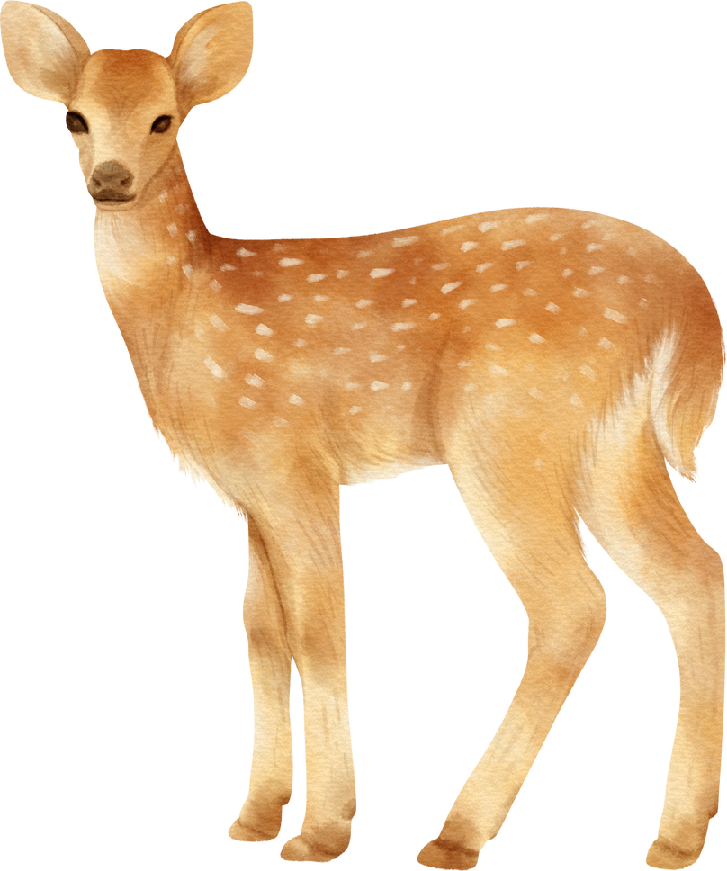
Motivation
Wildfires cause large-scale destruction of forests, property, and wildlife habitats, leading to severe environmental and economic losses.
Traditional wildfire monitoring methods, such as satellite imaging and manual observation, often suffer from delayed response times and limited accuracy.
The rapid advancement of UAVs (drones) and deep learning technologies provides a new opportunity for real-time, high-resolution, and automated wildfire detection.
Integrating image processing with deep learning enhances early detection capabilities, helping prevent large-scale fire spread.
Developing an efficient and accurate wildfire detection model contributes to sustainable disaster management and environmental protection efforts.

Slide 4
Literature Review
Sr. No. | Name of the Study | Features | Methodology | Research Gaps
1 | Barmpoutis et al., Sensors 2020 — Optical remote sensing review | Conducts a survey of terrestrial, air and satellite fire detection systems | It conducts a review of the existing systems for wildfire detection | There is no experimental validation conducted. UAVs are discussed but no proper large scale data
2 | Bouguettaya et al., Signal Processing 2022 — UAV + deep learning review | Conducts a survey of UAV based fire detection using deep learning | It performs a comparison between different methodologies. It also performed image classification, object detection and semantic segmentation | There is no implementation performed and more focused on theoretical part
3 | Yar et al., ISPRS JPRS 2023 — Attention-CNN for adverse weather (ADSF) | Has the ADSF dataset with different conditions like fog, haze and at night | They collected UAV and satellite imagery and generated synthetic adverse condition images | It contains many synthetic images rather than natural

Slide 5
Literature Review
Sr. No. | Name of the Study | Features | Methodology | Research Gaps
4 | Chen et al., Remote Sensing 2023 — UAV RGB–IR dataset | It introduces a UAV RGB-IR submission | It used UAVs to collect RGB and IR images and created an annotated dataset for detection and monitoring | The dataset is limited to specific regions with a small size and lacks adverse conditions
5 | Wang et al., Inventions 2022 — Reduce-VGGNet experiment | It applies deep learning in course-based experiment | It implemented various CNNs like Reduce-VGGNet for image classification and achieved an accuracy of 91.2% | It was tested on classification only on an experimental basis, with no scope for smoke detection.
6 | Buza & Akagić, Pattern Recognition Letters 2021 — Unsupervised flame segmentation | Proposes the RGB based detection | It proposed the unsupervised clustering on RGB for pixel segmentation and is tested on publicly available datasets | It struggles while differentiating between clouds and smoke and has no thermal data

Slide 6
Literature Review
Sr. No. | Name of the Study | Features | Methodology | Research Gaps
7 | Thangavel et al., Remote Sensing 2023 (Art. 720) & IEEE GRSL letter — Distributed Satellite System (DSS) | It talks about satellite based wildfire management system | It designed a Distributed Satellite System (DSS) and CNN models for fire detection and tested for near real-time scenarios | It has a limited spatial resolution and less effective for ground level firefighting systems.
8 | Ghali et al., Remote Sensing 2023 — DL for wildland fires | It has a large approach of Deep Learning approaches for classification, detection and segmentation. | It reviews and talks about the comparison of different deep learning methods and also analyzes different datasets | It lacks real world deployments and needs a bias control

Slide 7
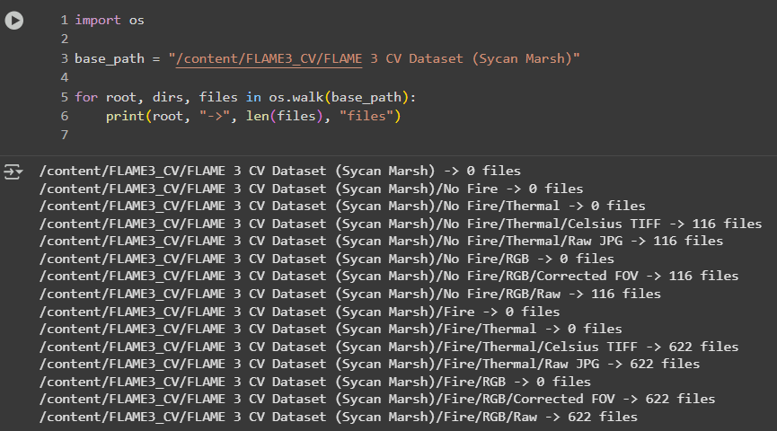
Methodology
1. Data Acquisition
Used FLAME 3 CV dataset (Sycan Marsh) from IEEE Dataport with RGB and thermal images.
Dataset contains Fire and No Fire classes.
Images are captured using UAV-mounted sensors in real wildfire scenarios.
Total of 738 image quartets (622 Fire, 116 No Fire).

Slide 8
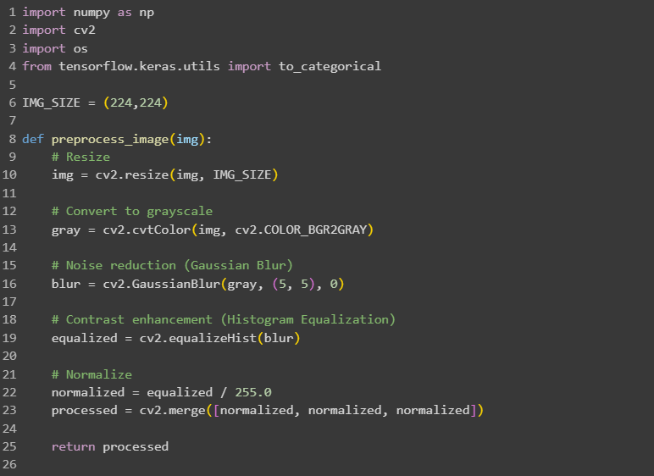
Methodology
2. Data Preprocessing
Resized images to 224 × 224 pixels for CNN input.
Converted BGR to RGB and normalized pixel values to [0,1].
Applied Gaussian blur and histogram equalization for noise reduction and contrast enhancement.
Notes:
Gaussian blur smooths the image by reducing high-frequency noise, which helps the CNN focus on main features rather than random variations.
Histogram equalization adjusts image contrast by redistributing pixel intensity values, enhancing the visibility of fire regions in both RGB and thermal images.

Slide 9
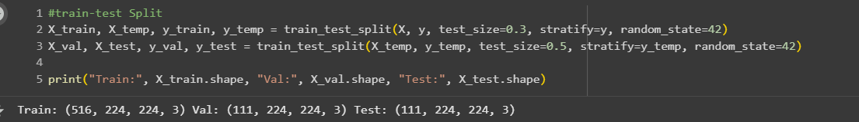
Methodology
3. Dataset Splitting
Divided dataset into Train (70%), Validation (15%), and Test (15%) sets.
Used stratified sampling to maintain class balance.
Ensured representation of both Fire and No Fire images in all subsets.
Notes:
Stratified sampling is a way of choosing a sample from a population so that all important groups are represented fairly.

Slide 10
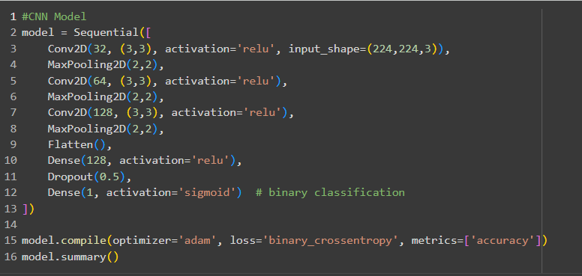
Methodology
4. Model Architecture
Implemented a CNN with convolutional, pooling, and fully connected layers.
Used ReLU activation and MaxPooling for feature extraction.
Final layer: Sigmoid activation for binary classification (Fire/No Fire).
Notes:
Model Architecture Explanation:
Input Layer:
The model takes images of size 224 × 224 pixels with 3 color channels (RGB).
Convolutional Layers (Conv2D):
Conv2D(32, (3,3), activation='relu'): Extracts 32 features from the image using 3×3 filters.
ReLU activation: Introduces non-linearity, helping the model learn complex patterns.
These layers detect edges, textures, and shapes in the image.
Pooling Layers (MaxPooling2D):
MaxPooling2D(2,2): Reduces the size of feature maps by half, keeping the most important information.
Helps in reducing computation and prevents overfitting.
Additional Conv + Pool Layers:
Second and third Conv2D layers increase the number of filters (64, 128) to detect more complex features.
Each Conv2D is followed by MaxPooling for downsampling.
Flatten Layer:
Converts the 3D feature maps into a 1D vector so it can be fed into fully connected layers.
Fully Connected (Dense) Layers:
Dense(128, activation='relu'): Learns combinations of features to make predictions.
Dropout(0.5): Randomly ignores 50% of neurons during training to prevent overfitting.
Output Layer:
Dense(1, activation='sigmoid'): Produces a probability between 0 and 1 for binary classification (Fire or No Fire).
Compilation:
Optimizer = Adam: Helps update weights efficiently during training.
Loss = Binary Cross entropy: Suitable for binary classification tasks.
Metrics = Accuracy: Measures how often the model predicts correctly.

Slide 11
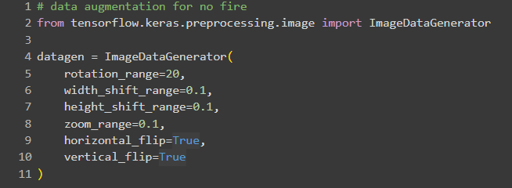
Methodology
5. Model Training
Optimizer: Adam with learning rate 0.001.
Loss function: Binary Cross-Entropy.
Trained for 20–30 epochs with batch size 32.
Applied data augmentation (flips, rotations) to improve generalization.
Notes:
Here’s what each parameter does:
rotation_range=20
Randomly rotates images up to 20 degrees in either direction.
width_shift_range=0.1
Randomly shifts images horizontally by up to 10% of the image width.
height_shift_range=0.1
Randomly shifts images vertically by up to 10% of the image height.
zoom_range=0.1
Randomly zooms images in or out by 10%.
horizontal_flip=True
Randomly flips images left to right.
vertical_flip=True
Randomly flips images top to bottom.
✅ In short: This code creates slightly rotated, shifted, zoomed, or flipped versions of your "No Fire" images so that the CNN sees more variety and learns better features, even if the original dataset is small.

Slide 12
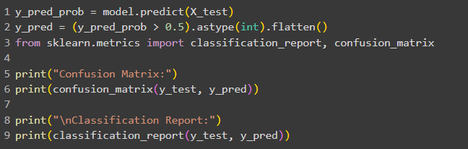
Methodology
6. Model Evaluation
Metrics: Accuracy, Precision, Recall, F1-score.
Confusion matrix used to visualize correct/incorrect classifications.
Tested on unseen data for real-world performance validation.

Slide 13
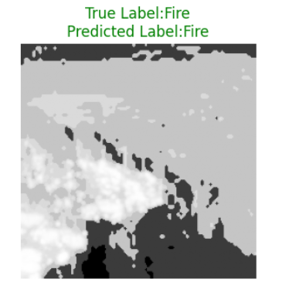
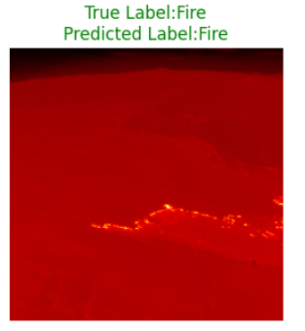
Methodology
7. Visualization & Deployment
Random test images visualized with predicted and true labels.
RGB and thermal images displayed using appropriate color maps.

Slide 14
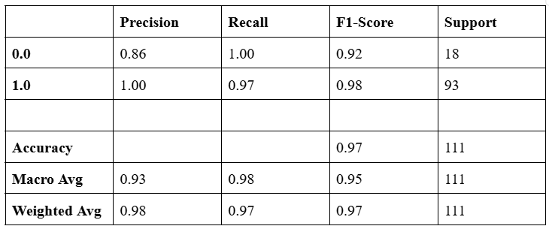
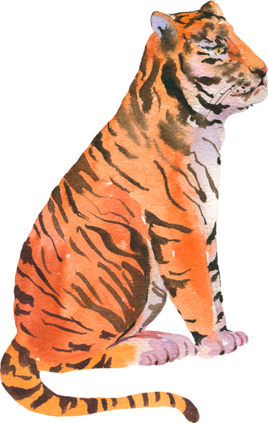
Results
The CNN model achieved overall test accuracy of 97% for classifying Fire and No Fire images.
Precision, Recall, and F1-score for Fire class: 0.86, 1.00, and 0.92 respectively; No Fire class: 1.00, 0.97, 0.97.
Notes:
1. Precision (P)
Measures how many of the predicted positive cases are actually positive.
$$\text{Precision}=\frac{\text{True} \text{Positives}\text{ (}\text{TP}\text{)}}{\text{True} \text{Positives}\text{ (}\text{TP}\text{)}+\text{False} \text{Positives}\text{ (}\text{FP}\text{)}}$$
2. Recall (R) / Sensitivity
Measures how many of the actual positive cases were correctly predicted.
$$\text{Recall}=\frac{\text{True} \text{Positives}\text{ (}\text{TP}\text{)}}{\text{True} \text{Positives}\text{ (}\text{TP}\text{)}+\text{False} \text{Negatives}\text{ (}\text{FN}\text{)}}$$
3. F1-Score
The harmonic mean of precision and recall. It balances both metrics.
$$\text{F}\text{1}\text{−}\text{Score}=2×\frac{\text{Precision}×\text{Recall}}{\text{Precision}+\text{Recall}}$$

Slide 15
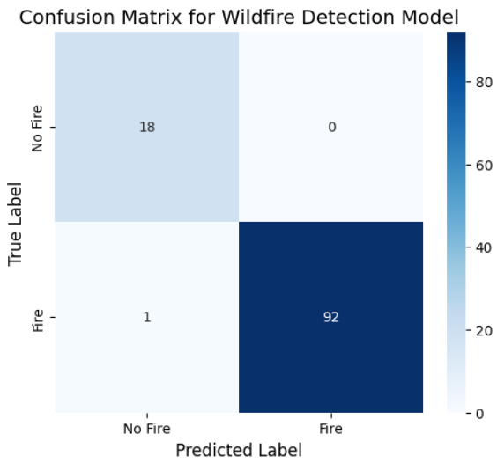
Results
Confusion Matrix:
True Fire correctly classified: 92
False Fire misclassified: 1
True No Fire correctly classified: 18
False No Fire misclassified: 0

Slide 16
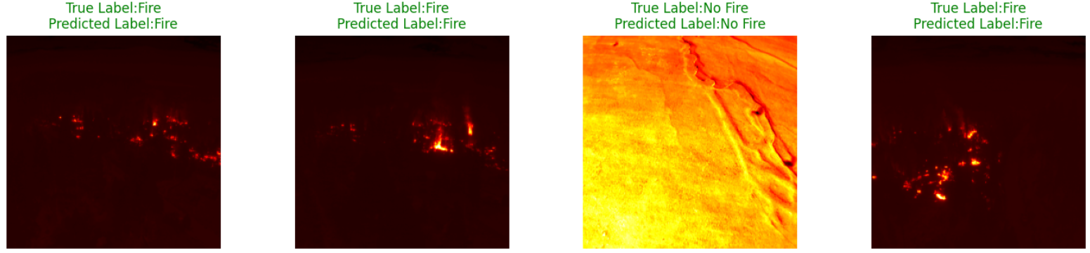
Results
Model effectively detected fire in RGB and Thermal images, even under challenging conditions.
High performance demonstrates robustness and reliability for real-time wildfire monitoring applications.
Visualizations confirmed the model accurately identifies fire regions and minimizes false alarms.

Slide 17
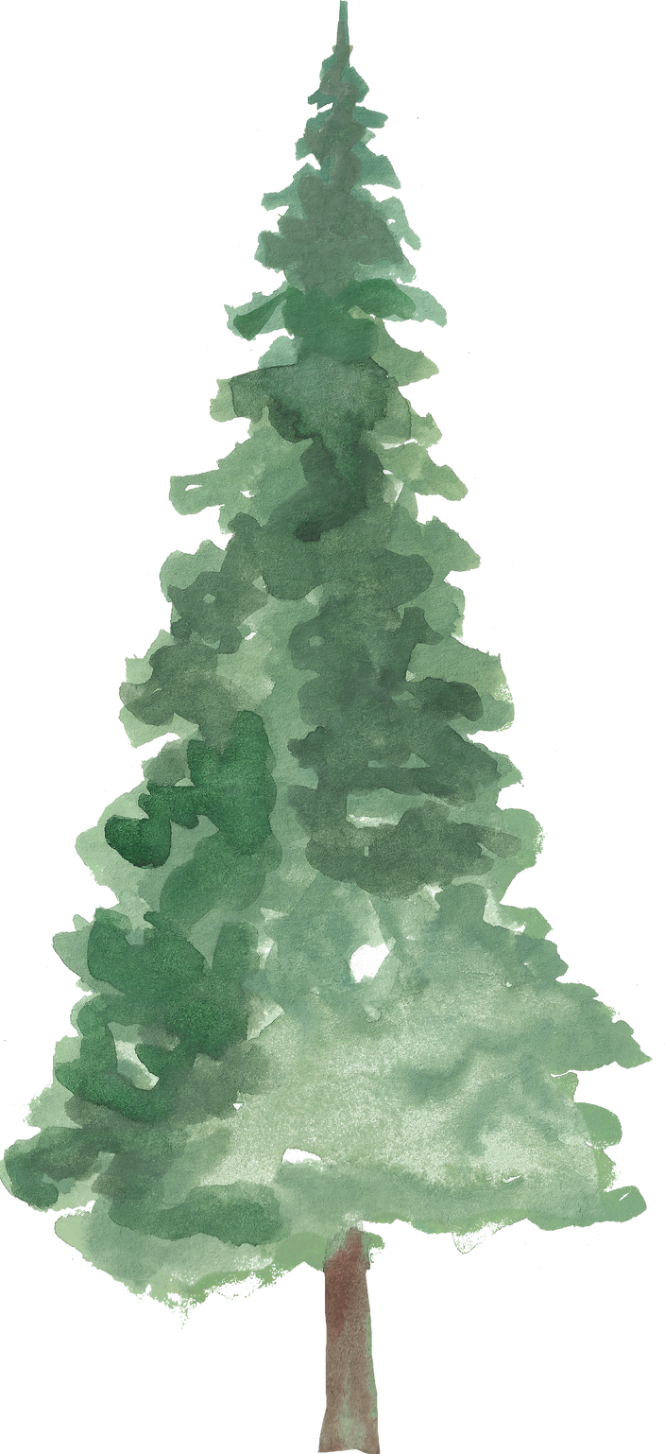
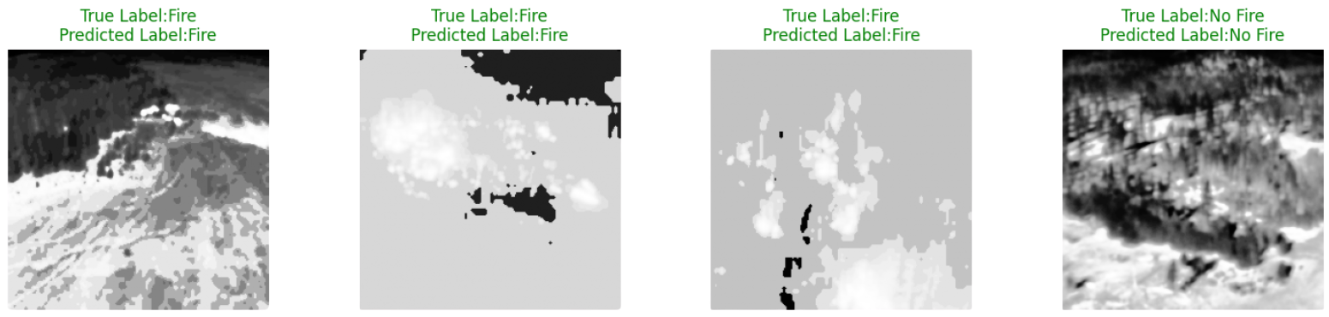
Conclusion
The project successfully developed a wildfire detection system using RGB and thermal imagery, integrated with a CNN model and image preprocessing techniques. The model achieved high accuracy (97%) with strong precision and recall, effectively detecting fire while minimizing false alarms. This demonstrates the system’s robustness and reliability, providing a practical framework for real-time wildfire monitoring and early disaster management.

Slide 18
REferences
[1] Food and Agriculture Organization (FAO), “FAO launches updated guidelines to tackle extreme wildfires,” FAO Newsroom, Jul. 2023.
[2] H. Ritchie, “Wildfires,” Our World in Data, 2022.
[3] Australian Institute for Disaster Resilience, “2019–20 Bushfires (Victoria),” AIDR Knowledge Hub, 2020.
[4] Country Fire Authority (CFA), “Major Fires: 2019–2020 Bushfires,” CFA Victoria, 2020.
[5] Department of Environment, Land, Water and Planning, “Ecosystem services from forests in Victoria: Impact of the 2019–20 bushfires,” Victorian Government, 2021.
[6] A. Barmpoutis, P. Papaioannou, K. Dimitropoulos, and N. Grammalidis, "A Review on Early Forest Fire Detection Systems Using Optical Remote Sensing," Sensors, vol. 20, no. 22, p. 6442, 2020.
[7] X. Chen et al., "Wildland Fire Detection and Monitoring Using a Drone-Collected RGB/IR Image Dataset," IEEE Access, vol. 10, Art. no. 3222805, 2022.
[8] L. Wang, H. Zhang, Y. Zhang, K. Hu, and K. An, "A Deep Learning-Based Experiment on Forest Wildfire Detection in Machine Vision Course," IEEE Access, vol. 11, Art. no. 3262701, 2023.
[9] A. Bouguettaya, H. Zarzour, A. M. Taberkit, and A. Kechida, "A review on early wildfire detection from unmanned aerial vehicles using deep learning-based computer vision algorithms," Signal Process., vol. 190, p. 108309, 2022.
[10] H. Yar, W. Ullah, Z. A. Khan, and S. W. Baik, "An Effective Attention-based CNN Model for Fire Detection in Adverse Weather Conditions," ISPRS J. Photogramm. Remote Sens., vol. 206, pp. 335–346, 2023.
[11] E. Buza and A. Akagic, "Unsupervised Method for Wildfire Flame Segmentation and Detection," IEEE Access, vol. 10, Art. no. 3176724, 2022.
[12] K. Thangavel, D. Spiller, R. Sabatini, P. Marzocca, and M. Esposito, "Near Real-Time Wildfire Management Using Distributed Satellite System," IEEE Geosci. Remote Sens. Lett., 2022.
[13] K. Bot and J. G. Borges, "A Systematic Review of Applications of Machine Learning Techniques for Wildfire Management Decision Support," Inventions, vol. 7, no. 1, p. 15, 2022.
[14] Bryce Hopkins, Leo O'Neill, Michael Marinaccio, Fatemeh Afghah, Eric Rowell, Russell Parsons, Sarah Flanary, "FLAME 3 - Radiometric Thermal UAV Imagery for Wildfire Management", IEEE Dataport, December 22, 2024, doi:10.21227/w0mz-aq48

Slide 19


THANK YOU

